Slide 1

Removal of Motion Artifacts from Photoplethysmogram Data for Feature Based Diagnosis of Atrial Fibrillation
By: Supervisor:
Salaar Ali Assad - 21100087 Dr. Muhammad Tahir
Sheraz Hassan - 21100285
Mohammad Afaq - 21100214
Department of Electrical Engineering
Lahore University of Management Sciences

Slide 2
Removal of Motion Artifacts from Photoplethysmogram
for Feature Based Diagnosis of Atrial Fibrillation

Slide 3
Motivation
19% of the Pakistani population suffers from Cardiovascular Diseases (CVDs), making it the leading non-communicable disease in the country [1]
Increasing demand for Electrocardiogram (ECG) which are uncomfortable, expensive, limited and require medical supervision [2]
Wrist worn photoplethysmogram (PPG) devices offer a simpler, cheaper and more comfortable alternative

Slide 4
Vision
Allow for remote and ambulatory cardiac health monitoring and assessment
Identification and removal of artifacts from the PPG data
Develop data processing algorithm for a robust diagnosis of cardiac disorders

Slide 5
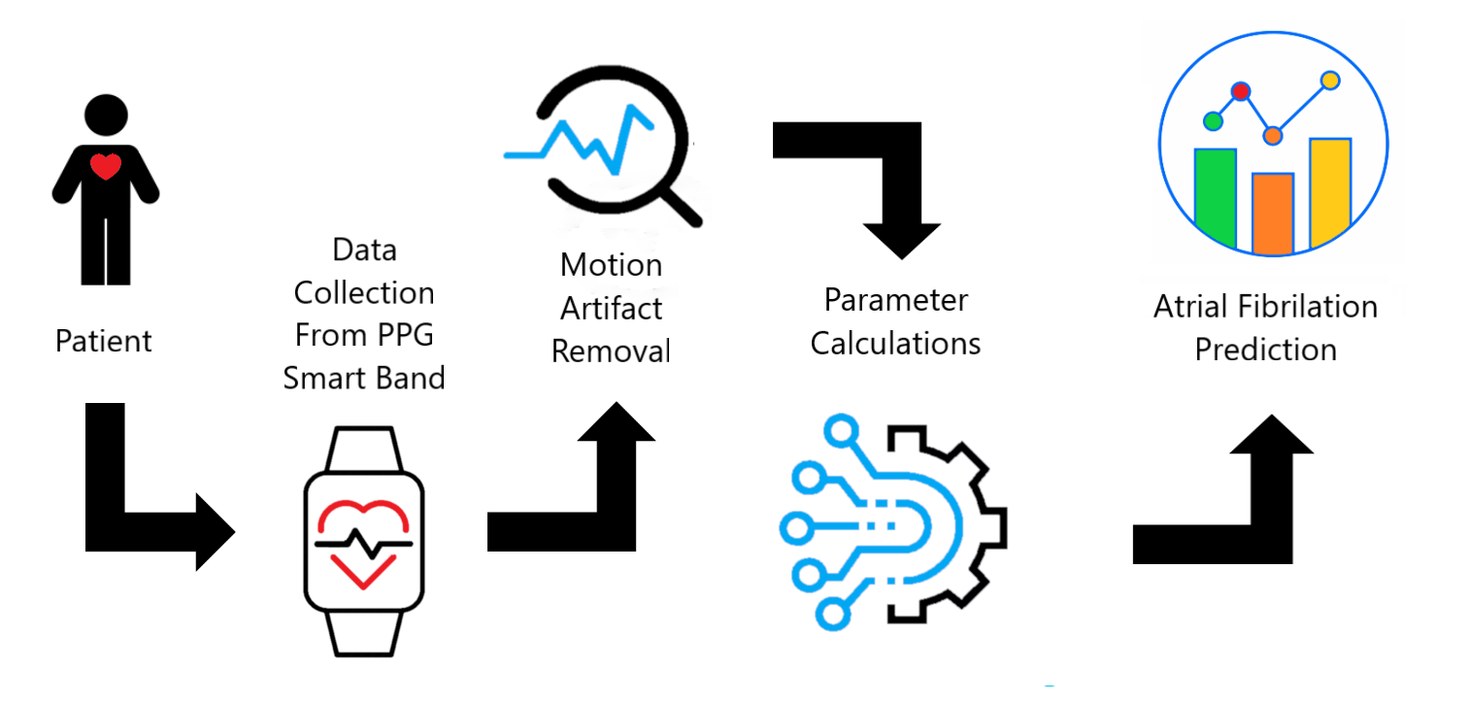
Block Diagram

Slide 6
Background Review

Slide 7
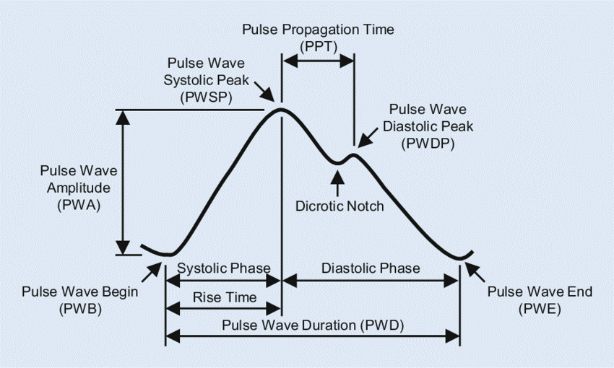
PPG Waveform
Important terms
Systolic Phase
Diastolic Phase
Pulse Wave Duration
Blood Volume Pulse (BVP)
PPG Waveform Notation [3]

Slide 8
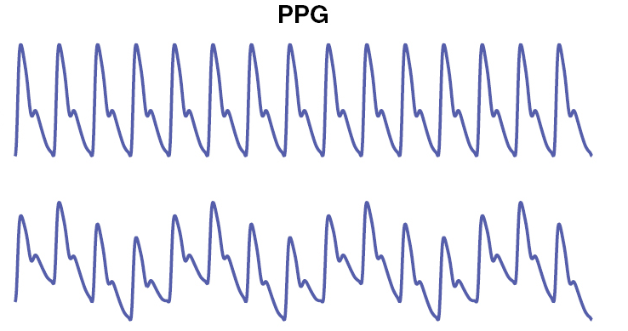
Perfusion Effect
Variation of blood flow volume in capillary network and the surrounding tissue
Causes a baseline shift in the raw PPG signal.
Factors
Breathing rate
Activity
Anxiety
Stress
And much more!
PPG Signal without perfusion (top) and with perfusion (bottom) [4]

Slide 9
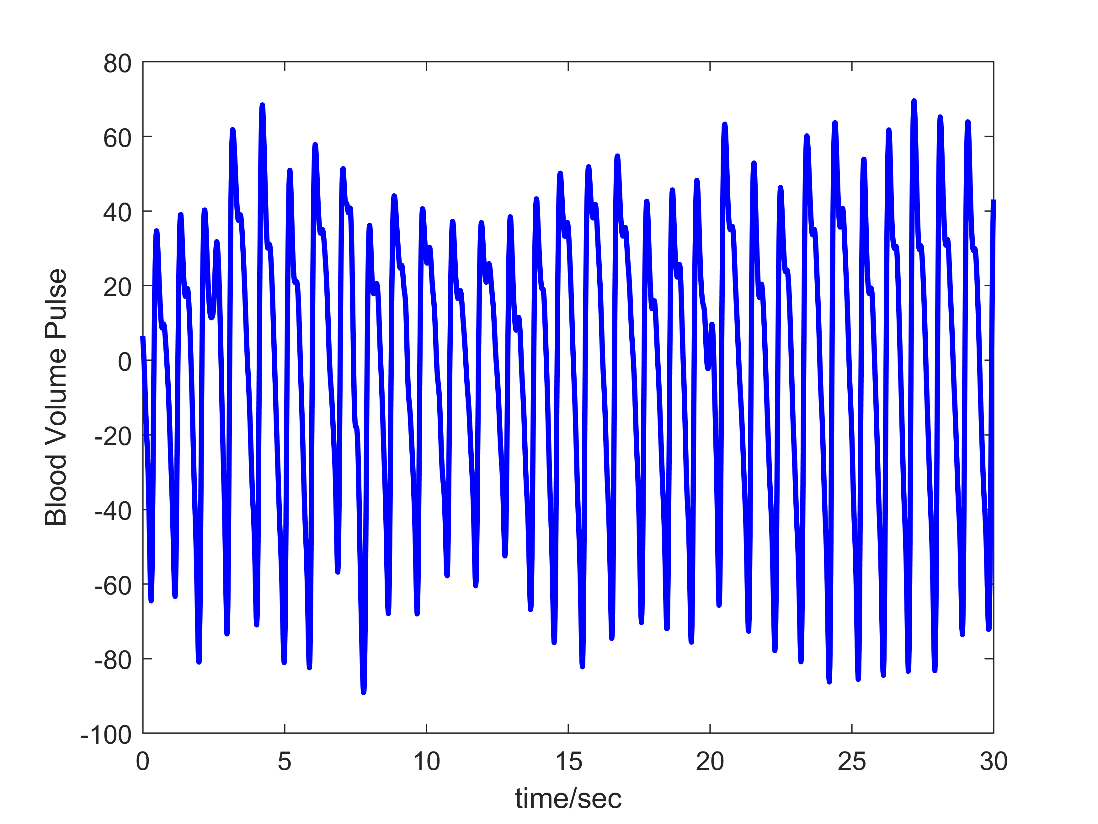
Motion Artifact
Disturbance in the contact between the skin and sensor from movement of the body
Introduces noise into the readings making them unreliable and inaccurate
Readings cannot detect Atrial Fibrillation (Afib) reliably
Healthy Patient with No Motion Artifacts

Slide 10
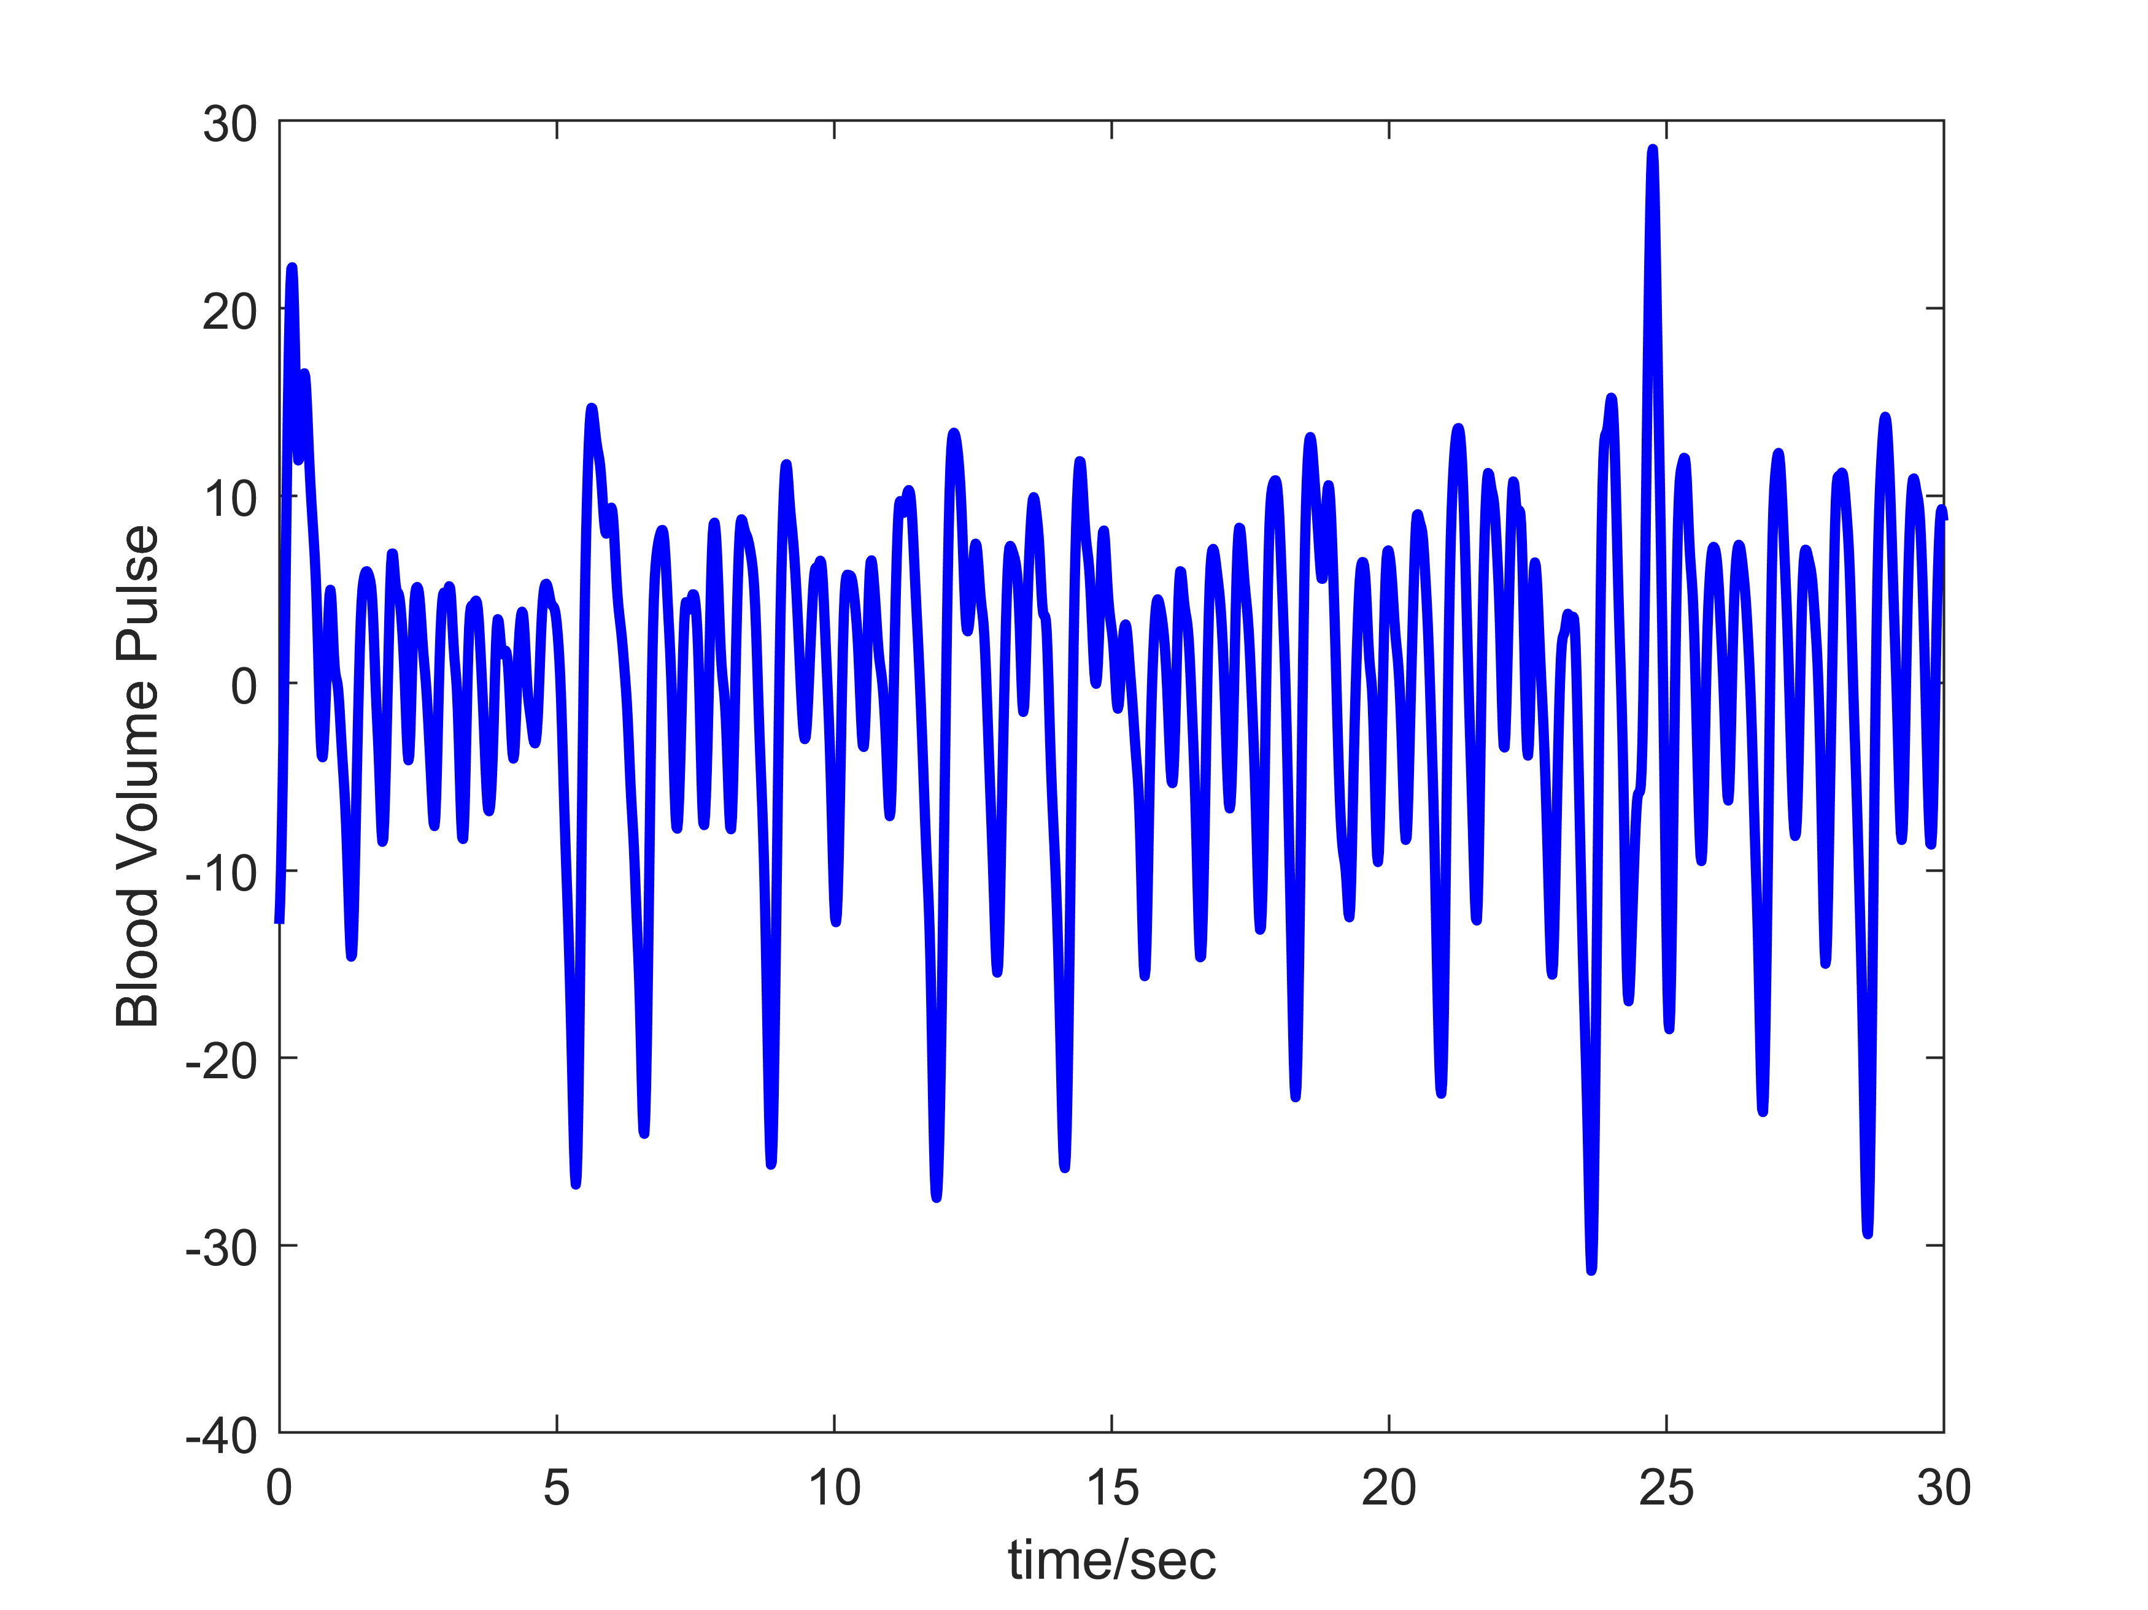
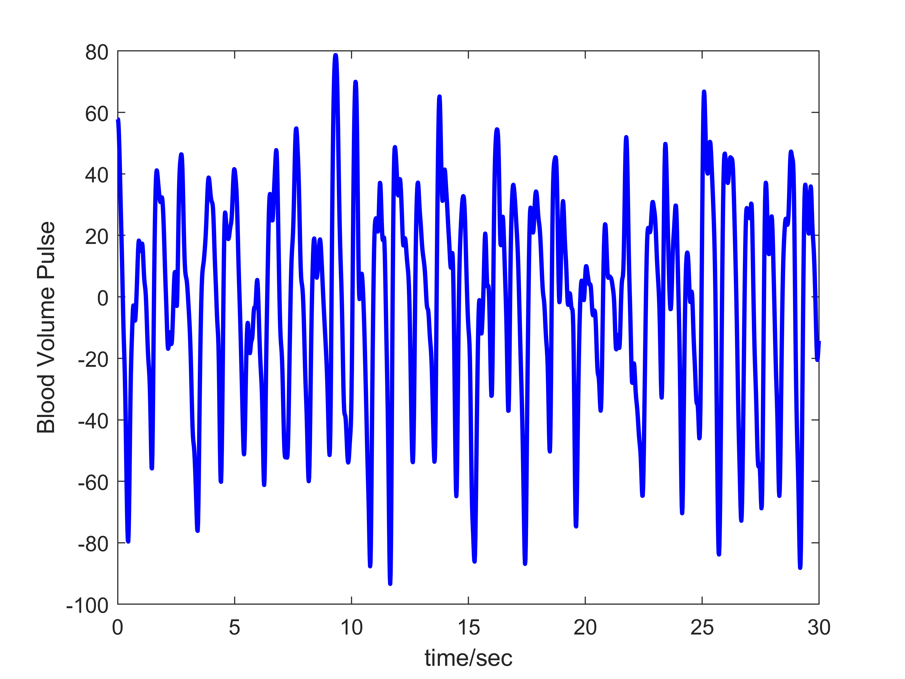
Corrupted Signal with Motion Artifacts
Patient with Afib

Slide 11
Methodology

Slide 12
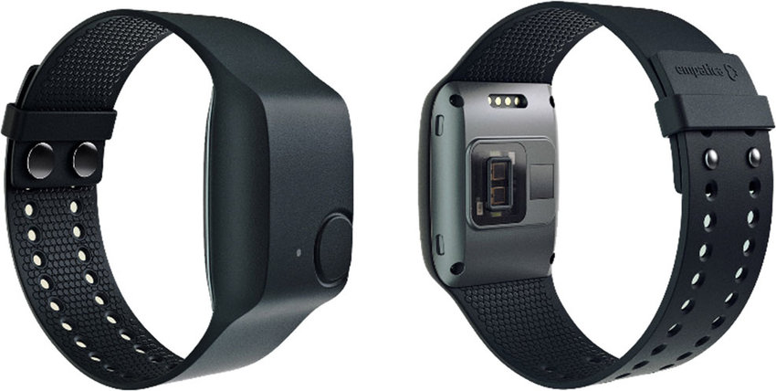
High-End Device
Empatica E4
4 LED’s and 2 photodiodes
PPG sensor (64HZ)
3-axis accelerometer (32Hz)
Temperature sensor
Pre-processing algorithm
Front and Back View of the Empatica E4

Slide 13
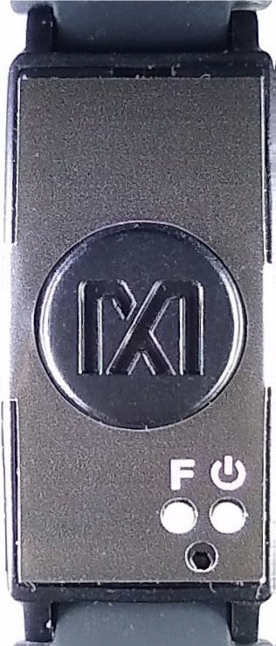
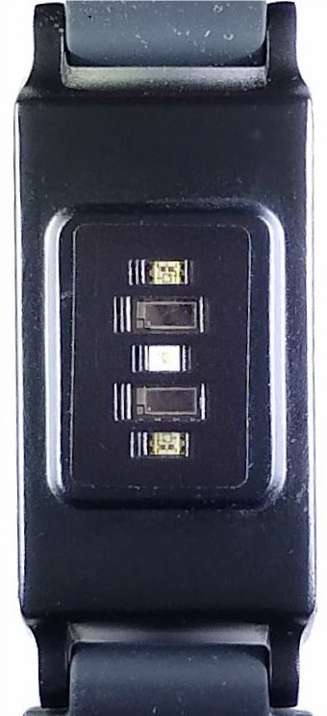
Low-End Device
Maxim MAXREFDES103#
2 LED’s and 2 photodiodes
IR emitter
Variable sampling rate
Front and Back View of the Maxim MAXREFDES103

Slide 14
Cost Analysis
 | Description | Qty | Unit Price (USD $) | Total price (USD $)
1- | Empatica E4 wristband | 1 | 1690 | 1690
2- | MAXREFDES103#: Health Sensor band | 3 | 199 | 597

Slide 15
Software
MATLAB
MATLAB is being used majorly for signal processing and analysis.
Jupyter Notebook
We used Jupyter notebook environment for all our python-based working.
Maxim UI/ Empatica UI
UI of Empatica was very straight forward to interact with whereas UI of Maxima required some understanding

Slide 16
Data sets
Three different types of data sets were used
Pre-existing data sets of 46 individuals
Data sets collected under homogenous environment using both E4 and Maxim.
Data sets from the IEEE signaling cup

Slide 17
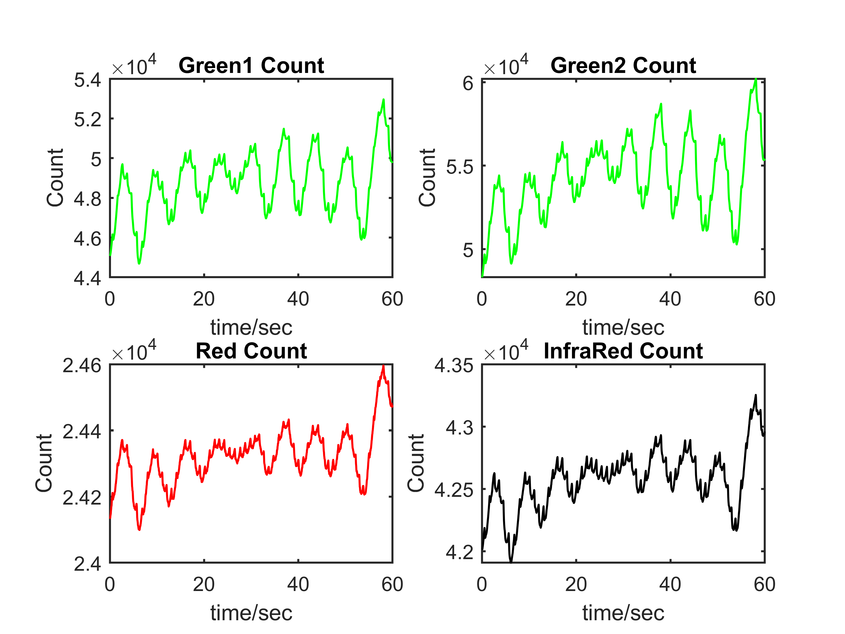
Data Quality Comparison - Maxim
Green least prone to motion artifacts
Red and IR as reference
17

Slide 18

Data Quality Comparison - Maxim
Sampling rate/Hz | Sampling average | Averaged sampling rate/Hz
64 | 1 | 64
128 | 2 | 64
256 | 4 | 64
512 | 8 | 64
1024 | 16 | 64
Average Sampling rate = $\frac{\text{Sampling} \text{Rate}}{\text{Sampling} \text{Average}}$
18

Slide 19
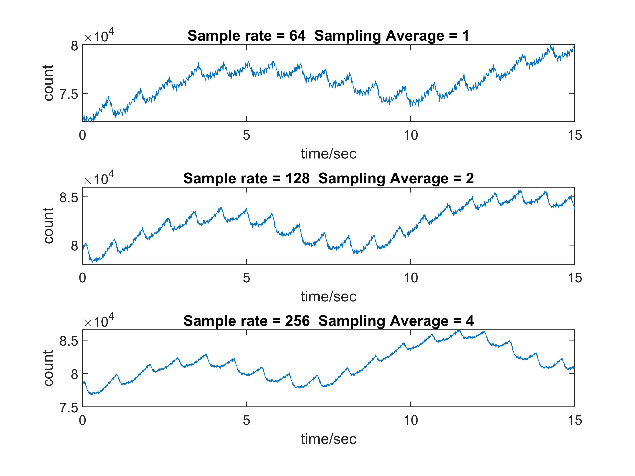
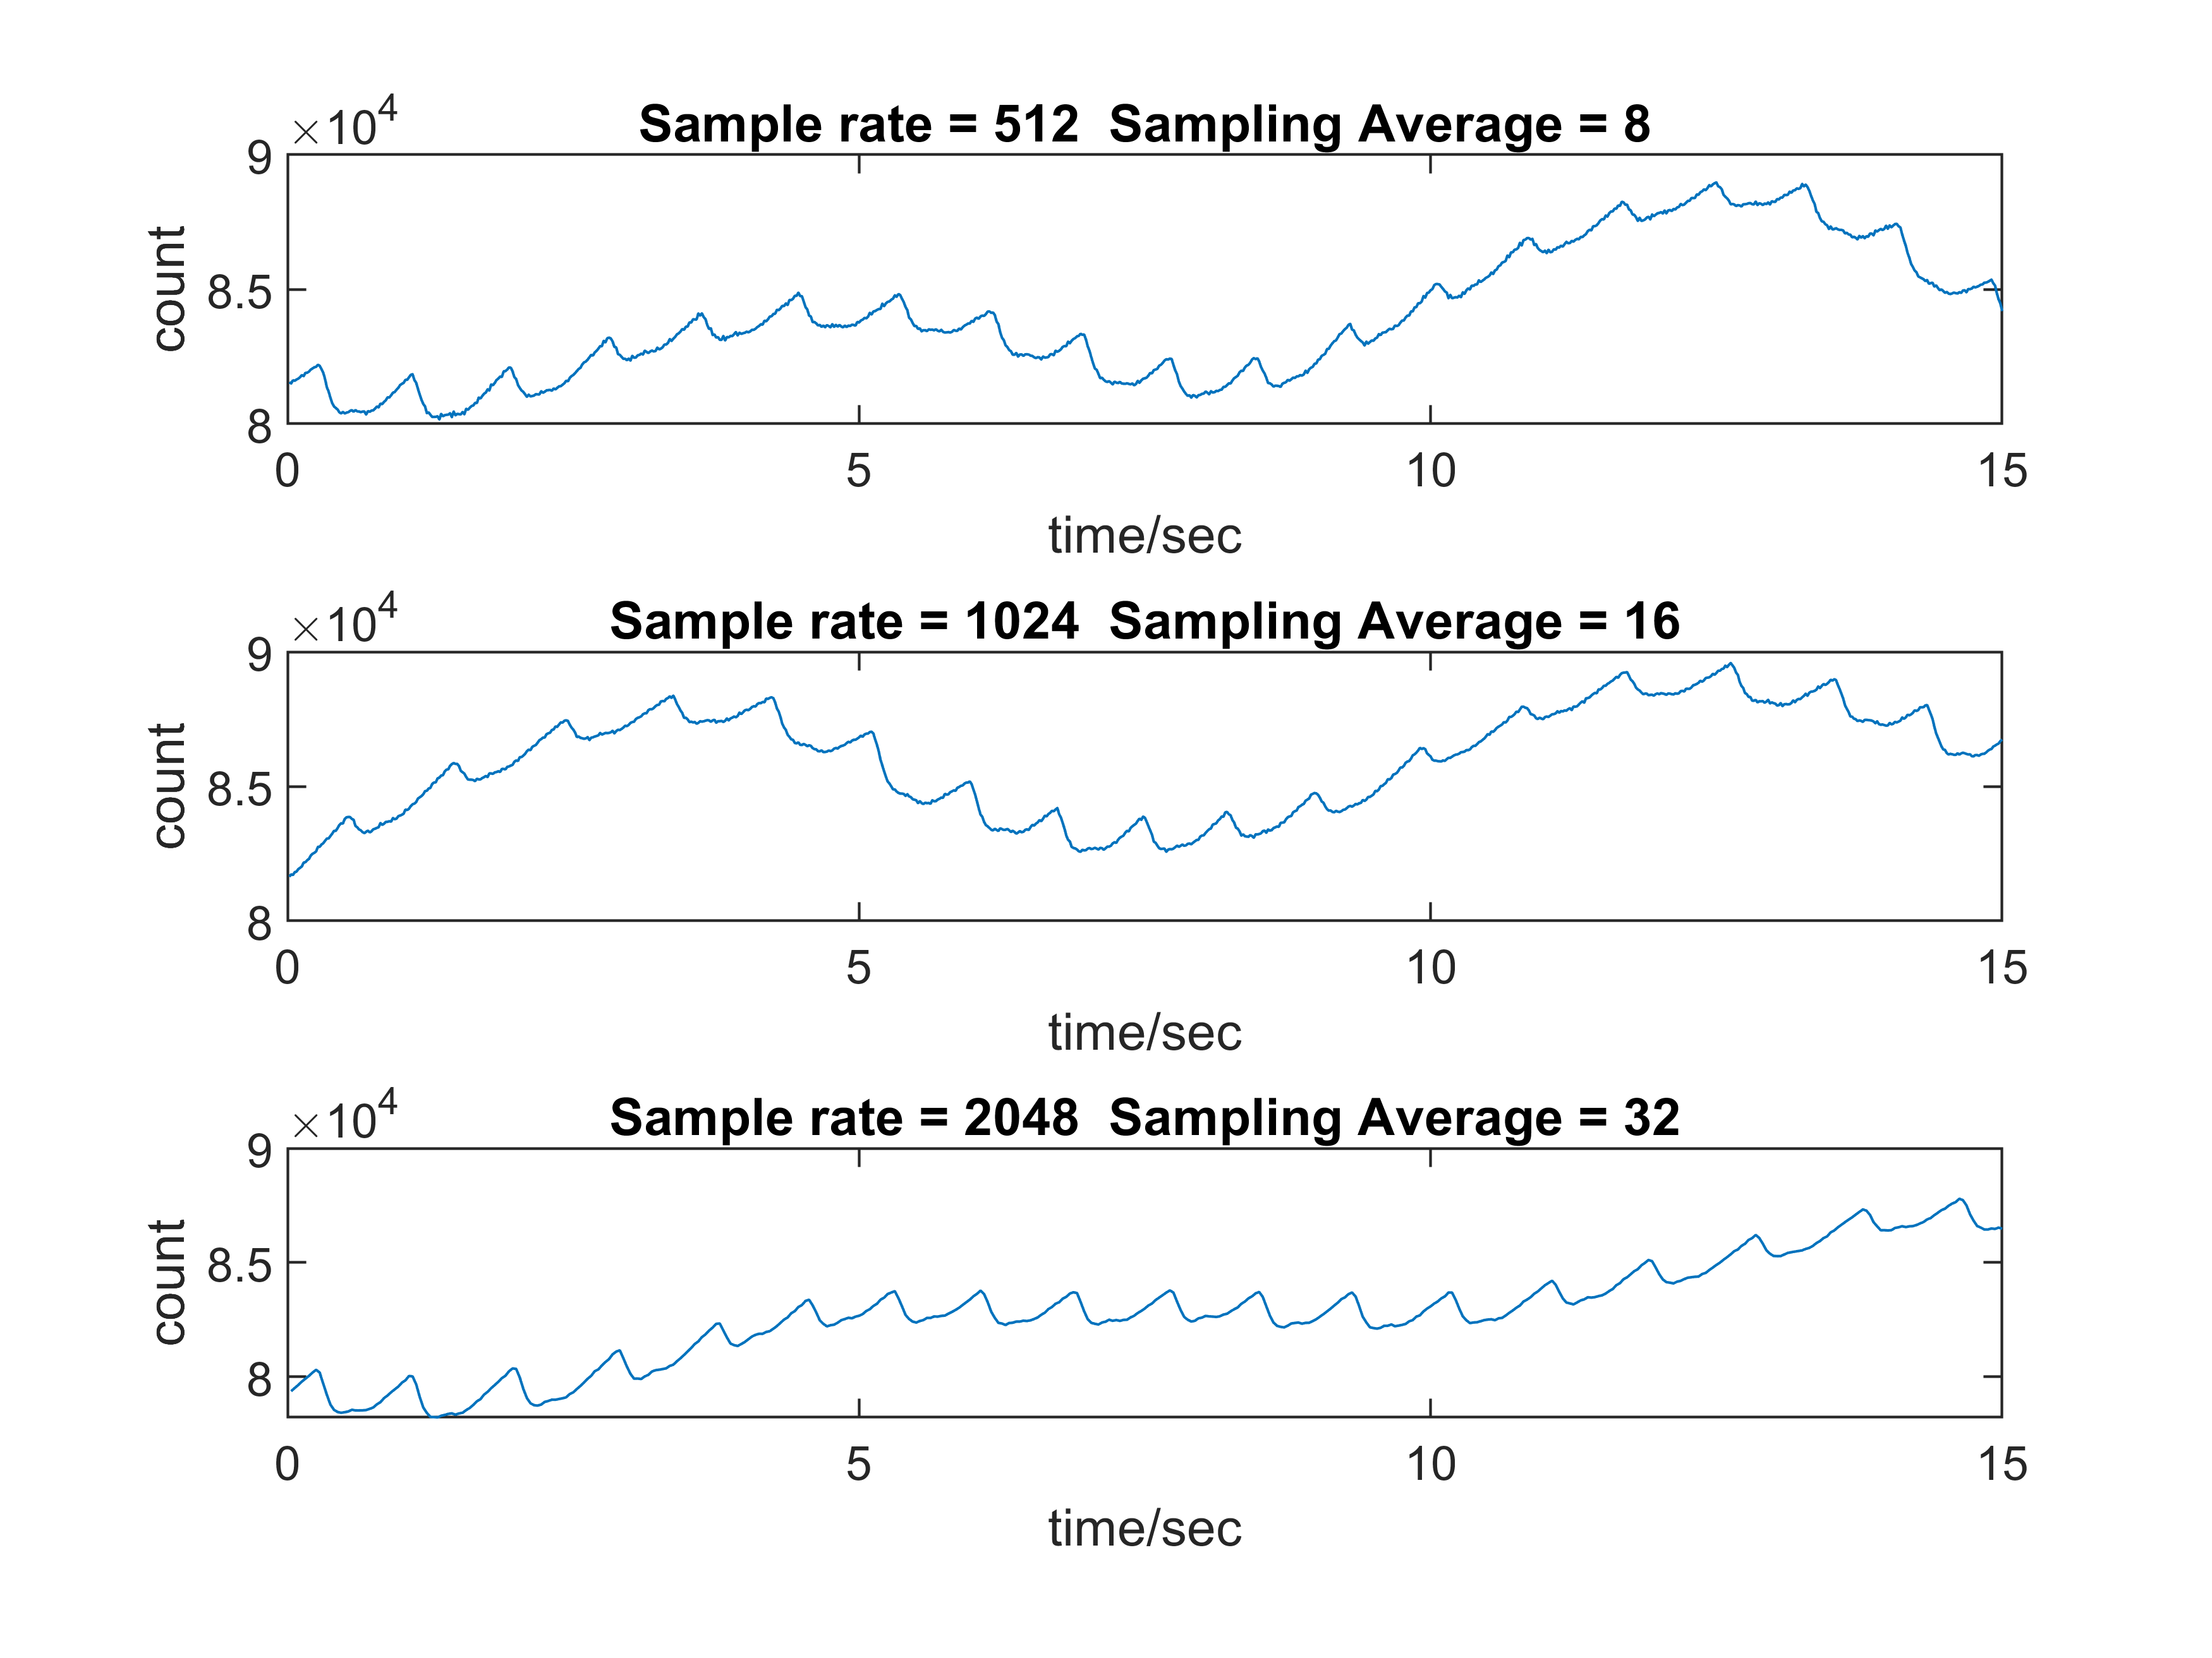

Slide 20
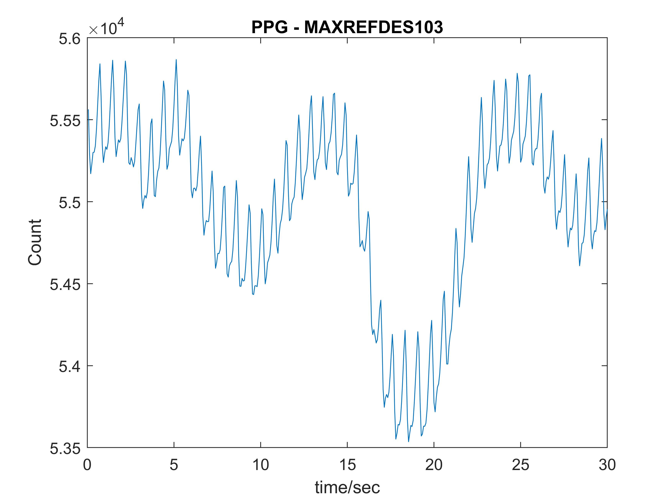
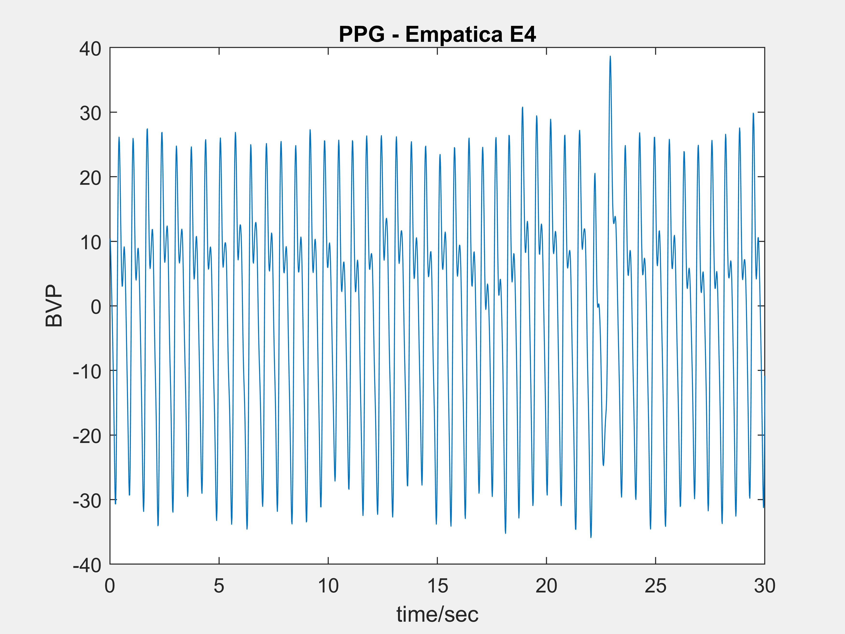
Low-end vs High-end
E4 Signal = PPG waveform + noise (1)
MAXREFDES103 Signal = Perfusion waveform + PPG waveform + noise (2)
20

Slide 21
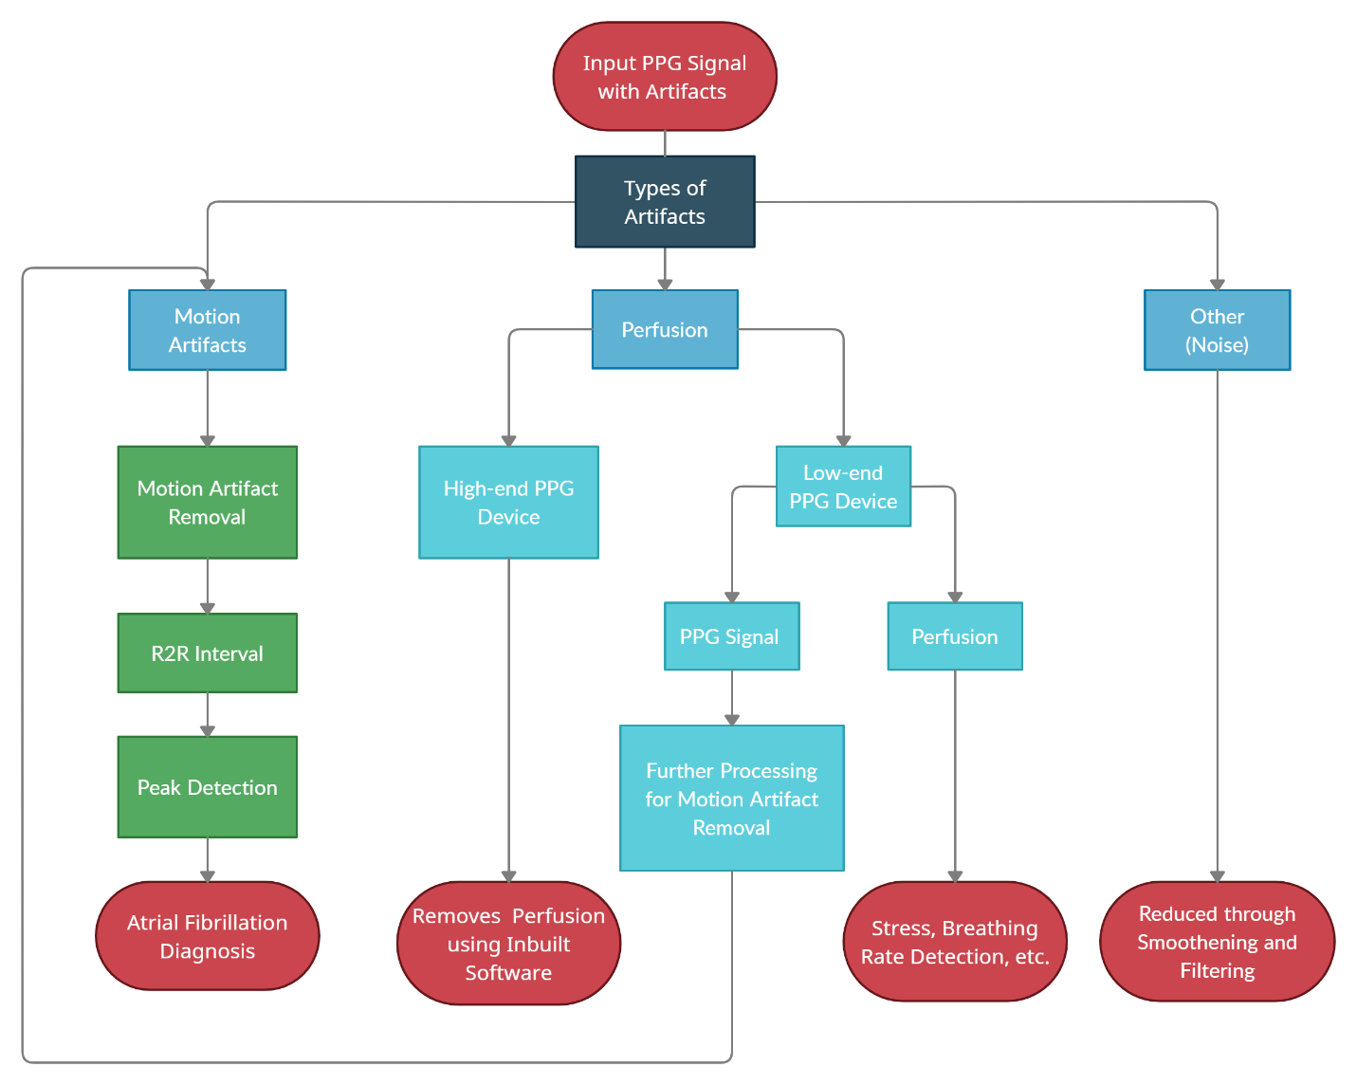
System level design of Raw PPG data
Raw PPG data contains 3 types of artifacts
Motion
Perfusion
Noise

Slide 22
Separating Perfusion and PPG Waveform from Raw PPG Signal

Slide 23
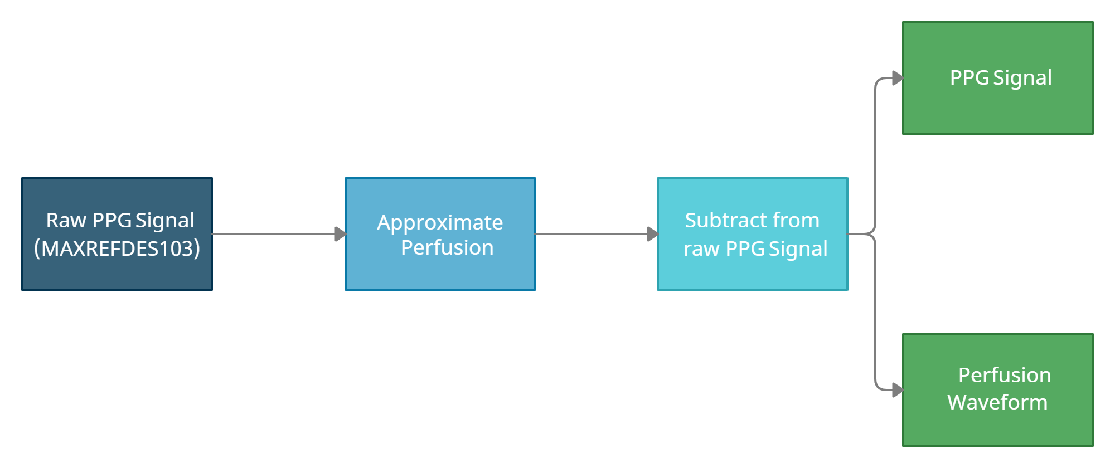
Approximate Perfusion Waveform using a Polynomial

Slide 24
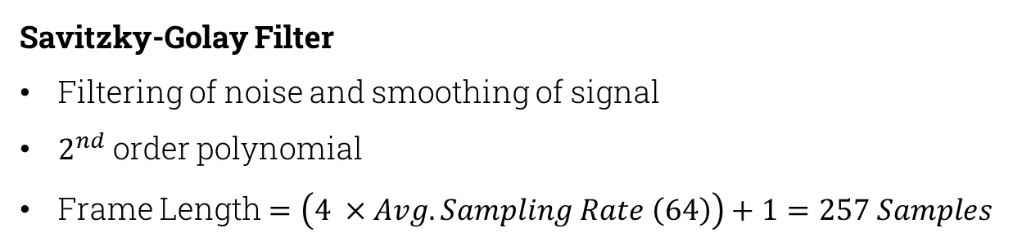
Approximate Perfusion
Savitzky-Golay Filter
Filtering of noise and smoothing of signal
$2^{nd}$ order polynomial
Frame Length $=\left(4 ×Avg. Sampling Rate \left(64\right)\right)+1=257 Samples$

Slide 25
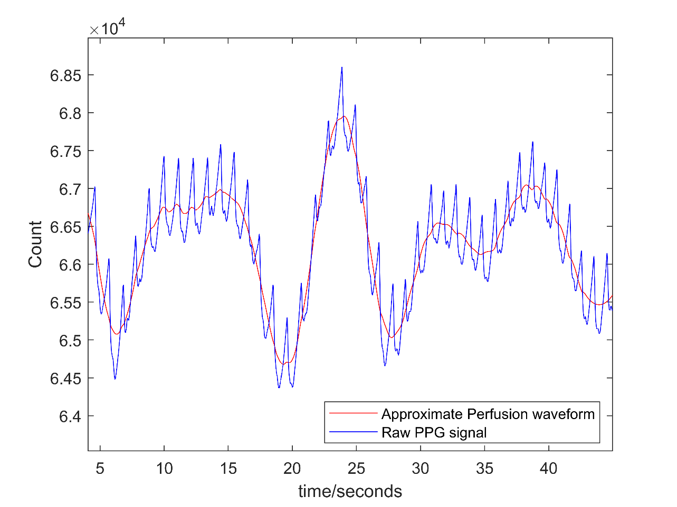
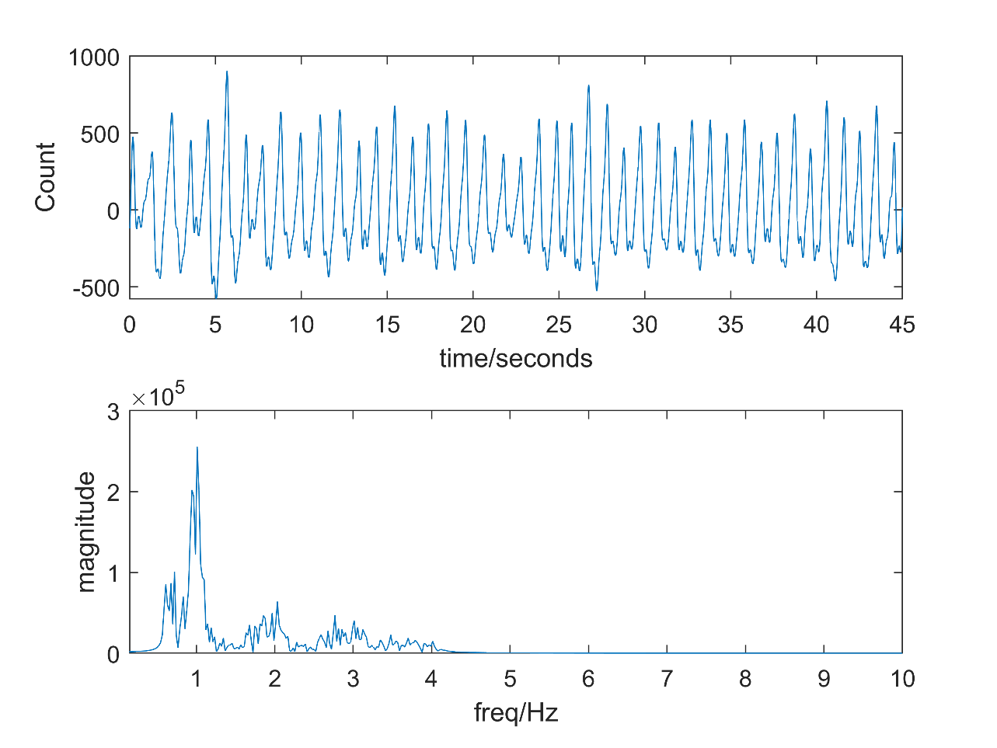
Raw PPG Signal (Blue) along with the approximated Perfusion Waveform (Red)
PPG Waveform obtained along with its Frequency Plot

Slide 26
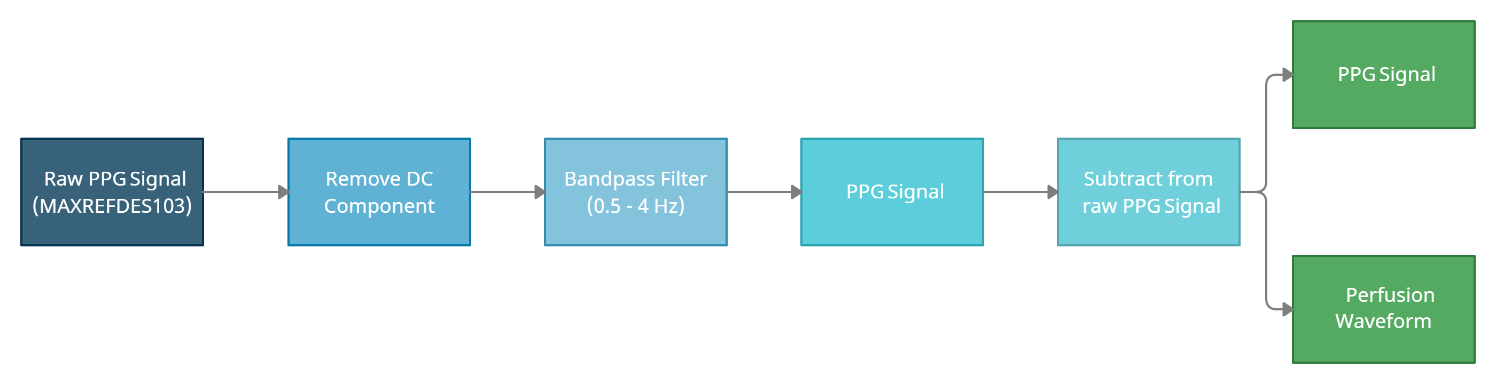
Filter out PPG Waveform

Slide 27
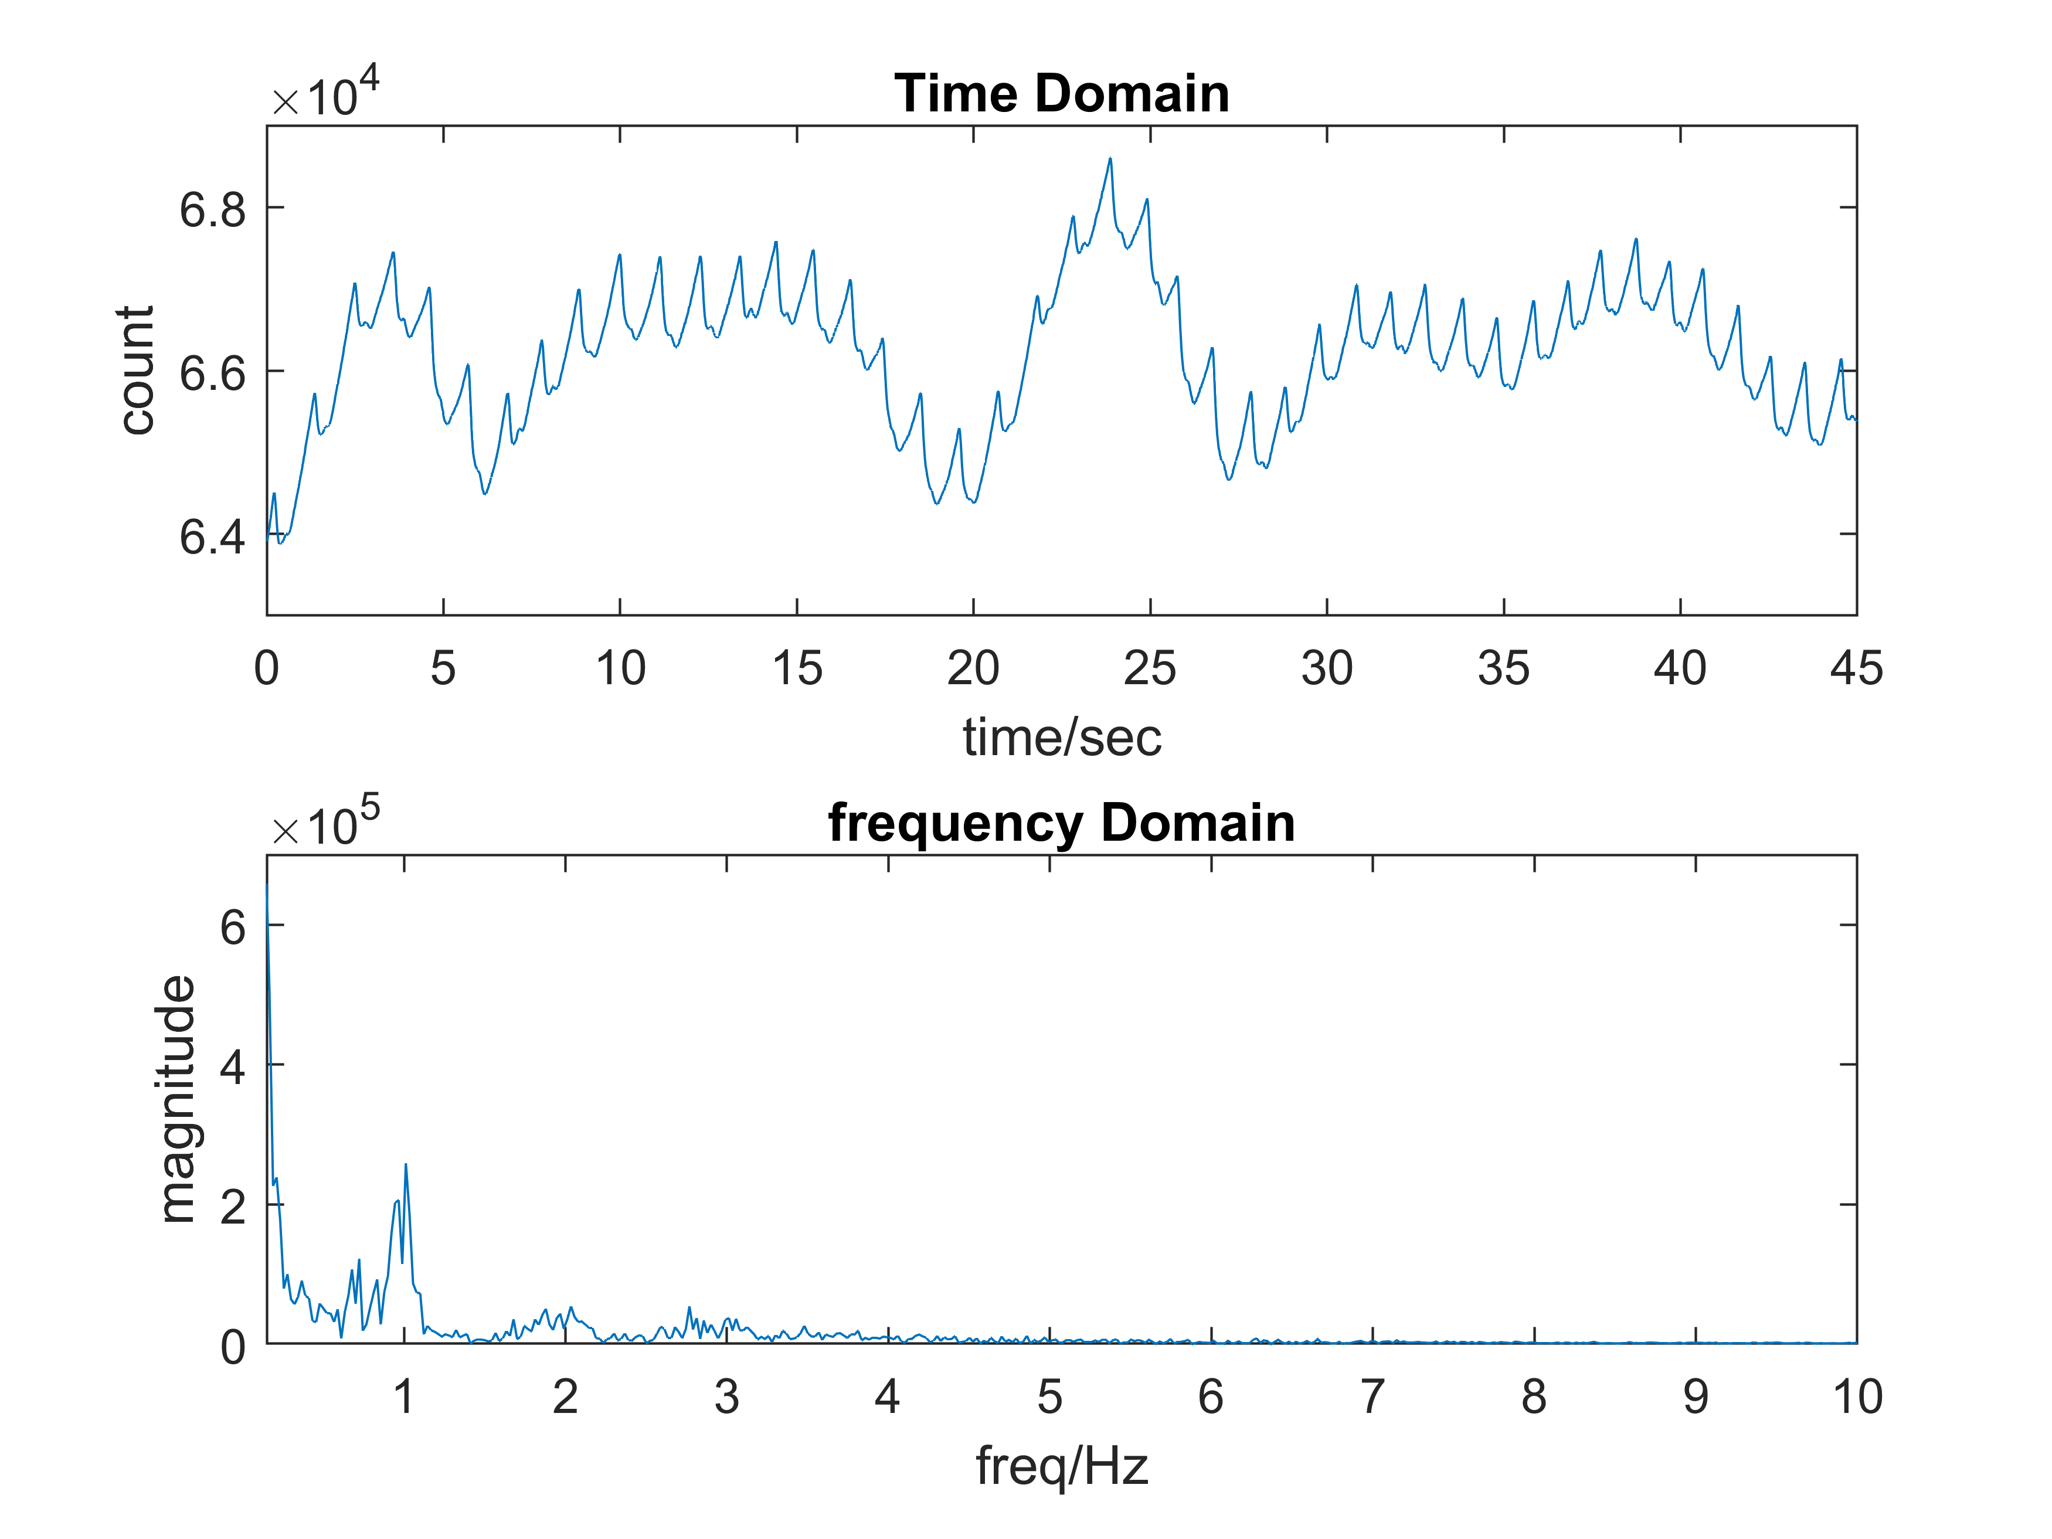
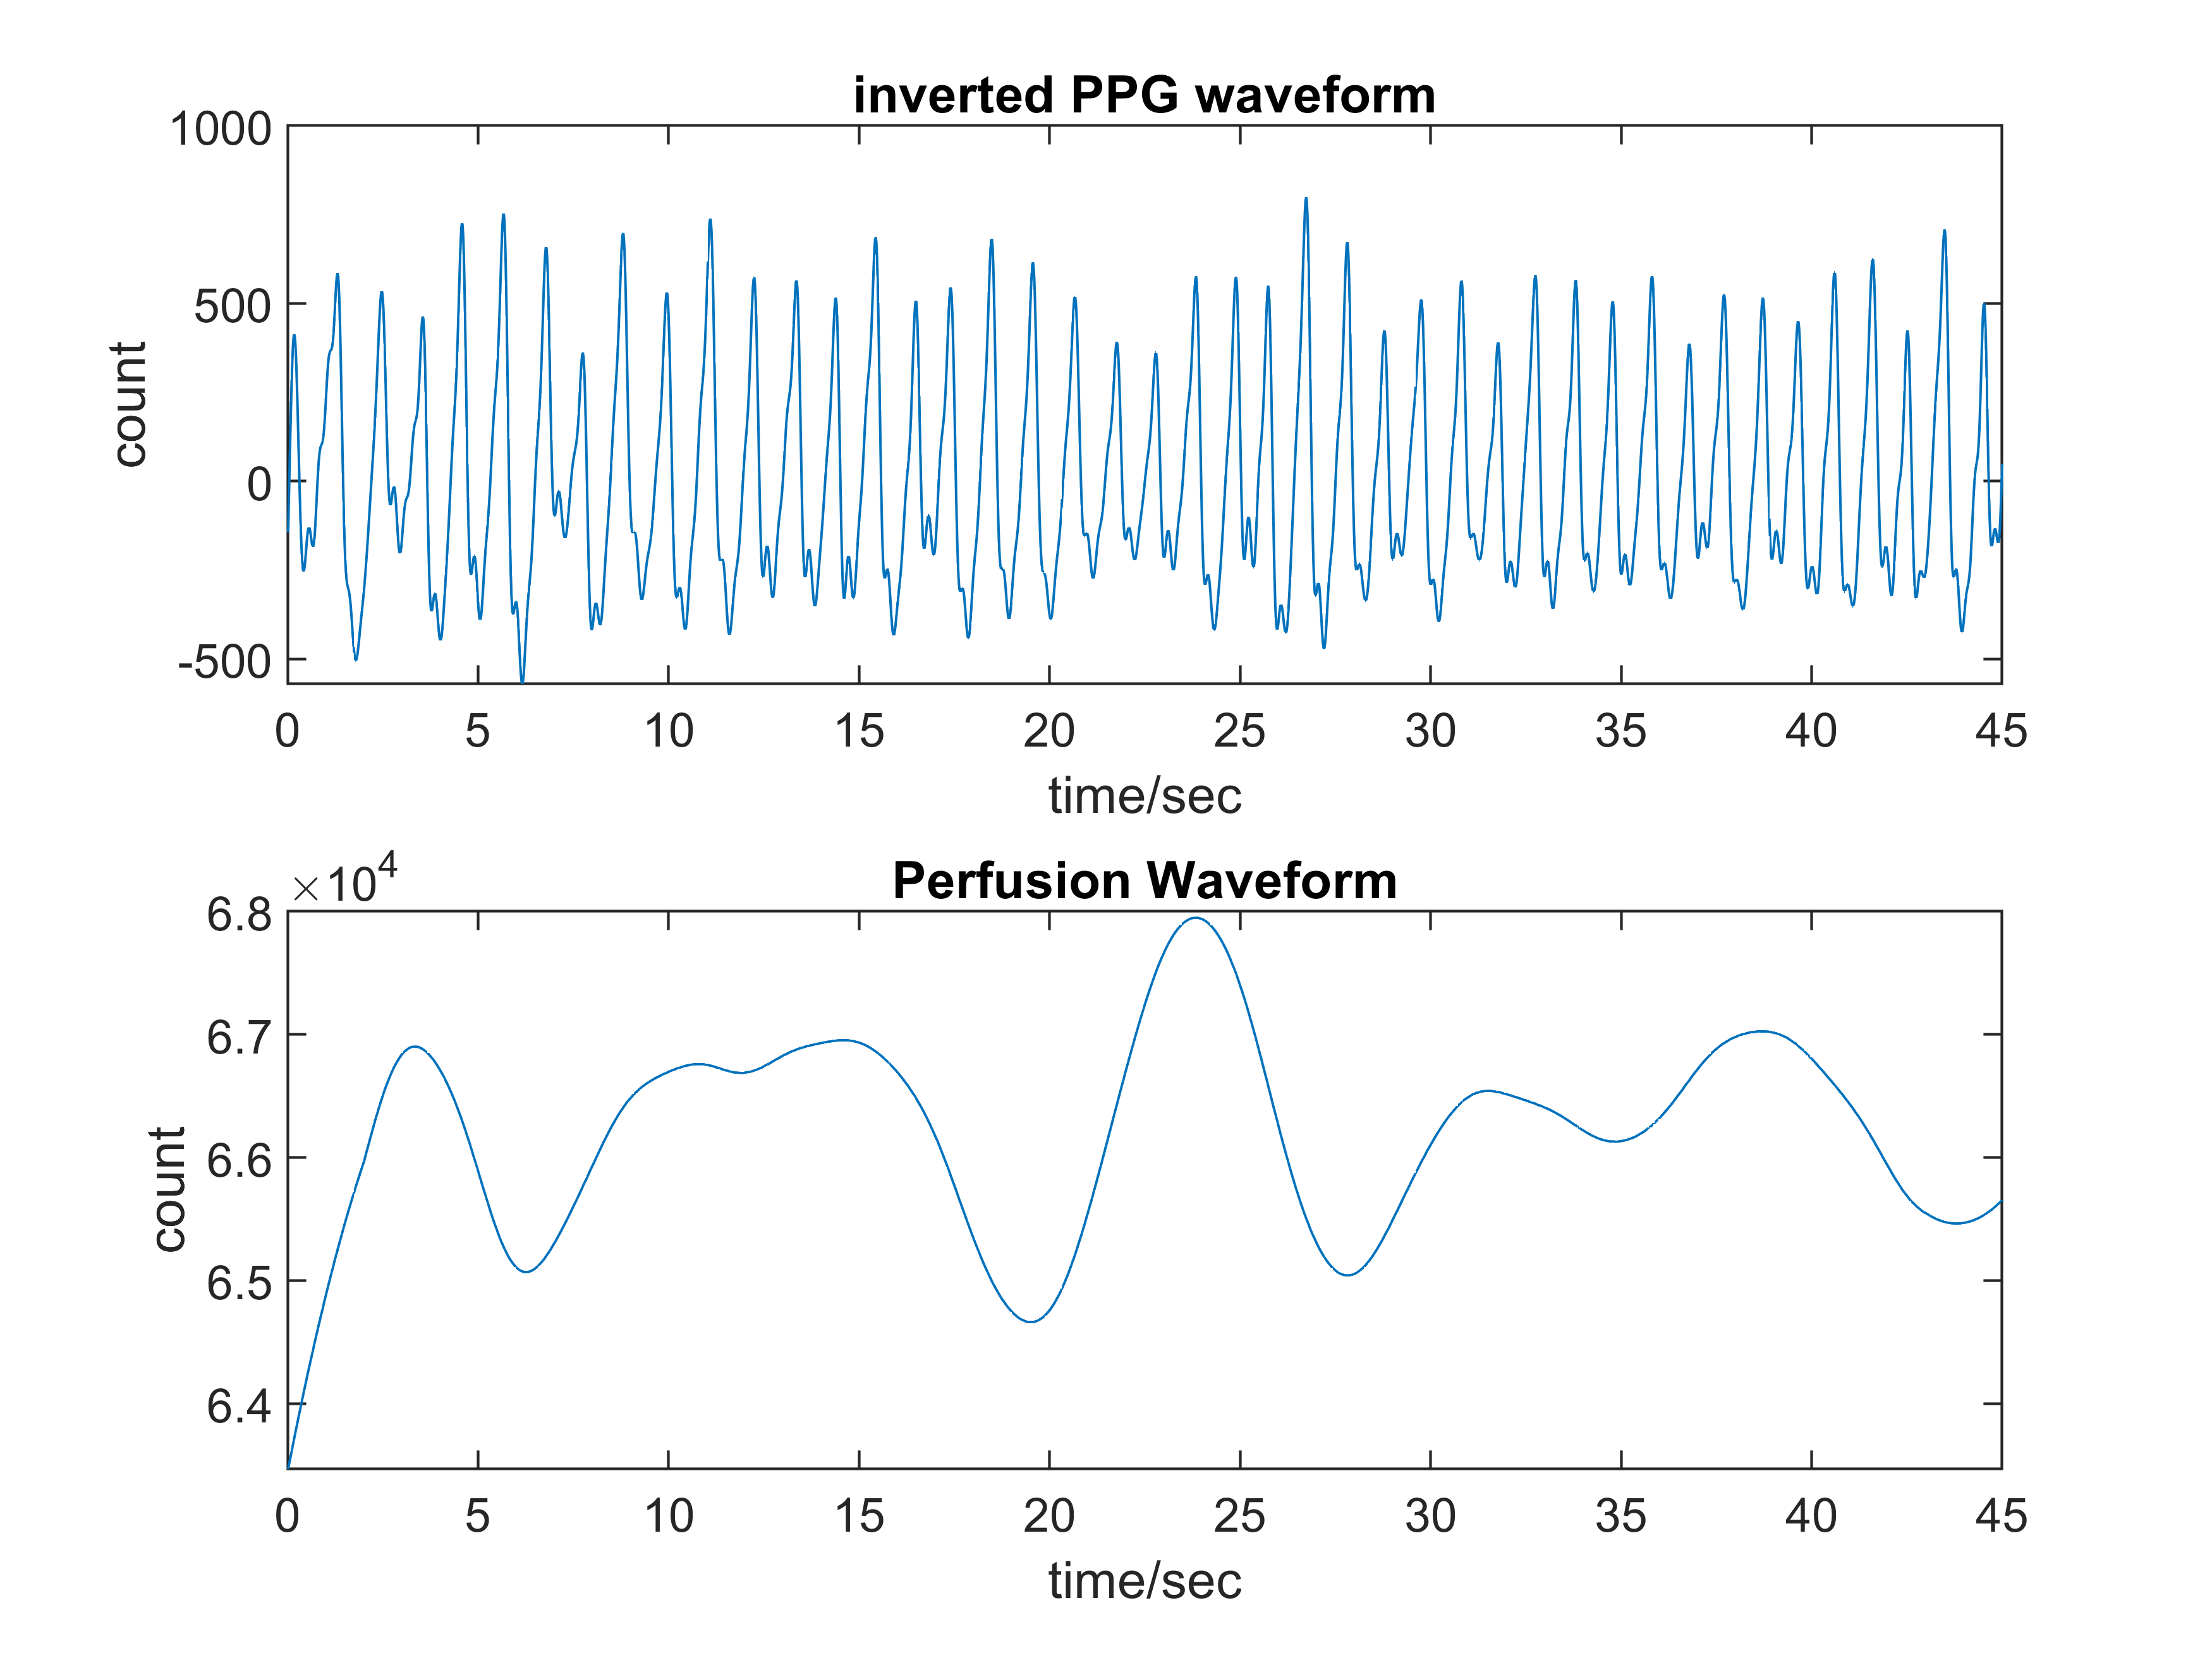
Raw PPG signal and its frequency plot from MAXREFDES103
PPG waveform and Perfusion waveform obtained by filtering using a band pass filter

Slide 28
Parameter Estimation

Slide 29
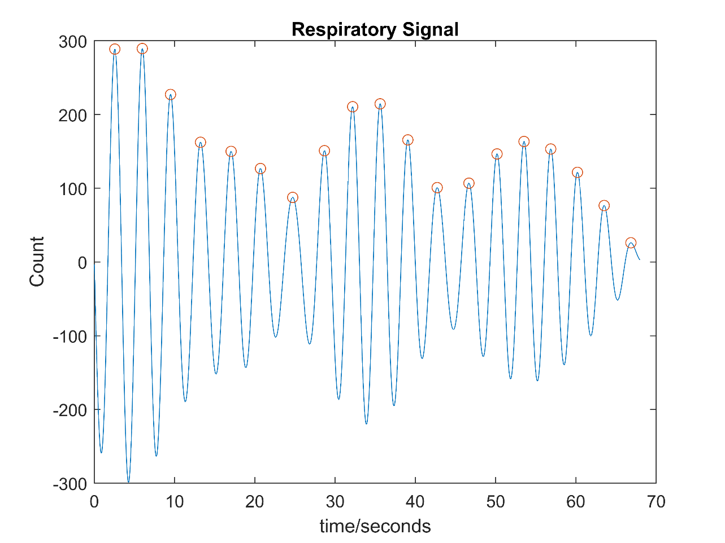
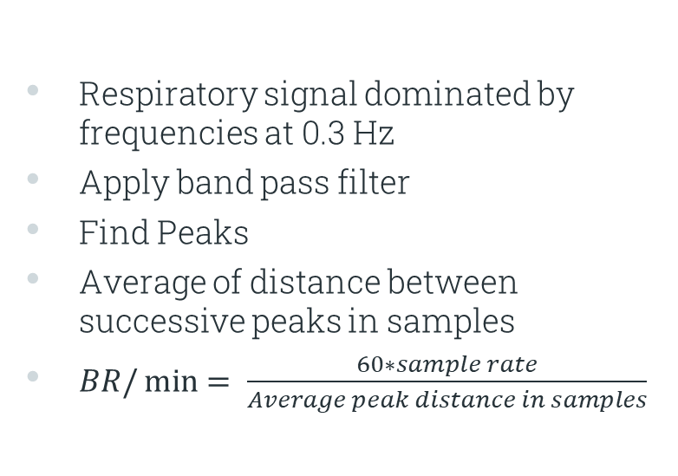
Breath Rate
Respiratory signal dominated by frequencies at 0.3 Hz
Apply band pass filter
Find Peaks
Average of distance between successive peaks in samples
$BR/\min{= \frac{60∗sample rate}{Average peak distance in samples}}$

Slide 30
Motion Artifacts Removal

Slide 31
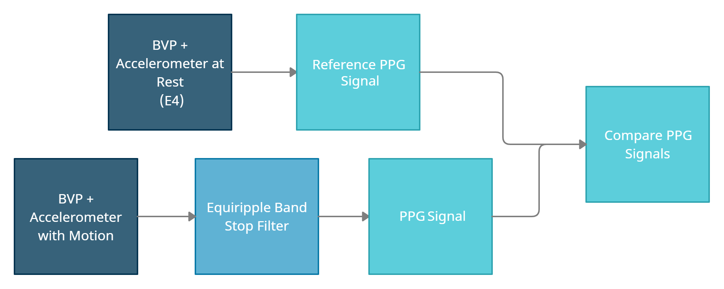
Accelerometer correlation?

Slide 32
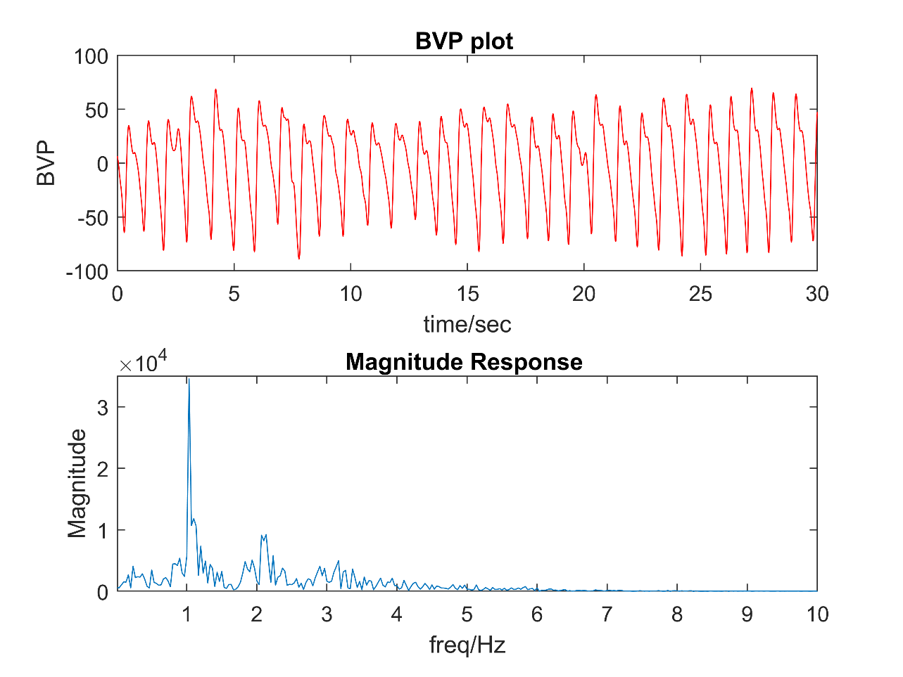
Analysis
1) Individual at rest
Reference signal

Slide 33
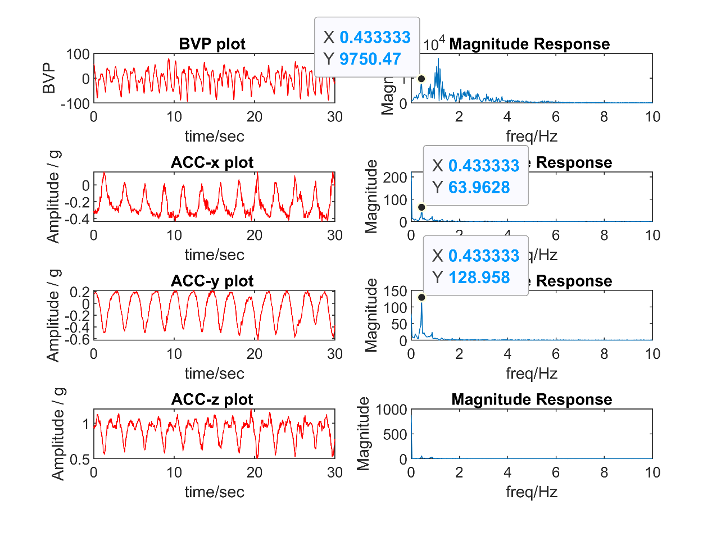
2) Individual with a controlled vertical motion
BVP of a healthy individual with motion along with its magnitude spectrum using the E4

Slide 34
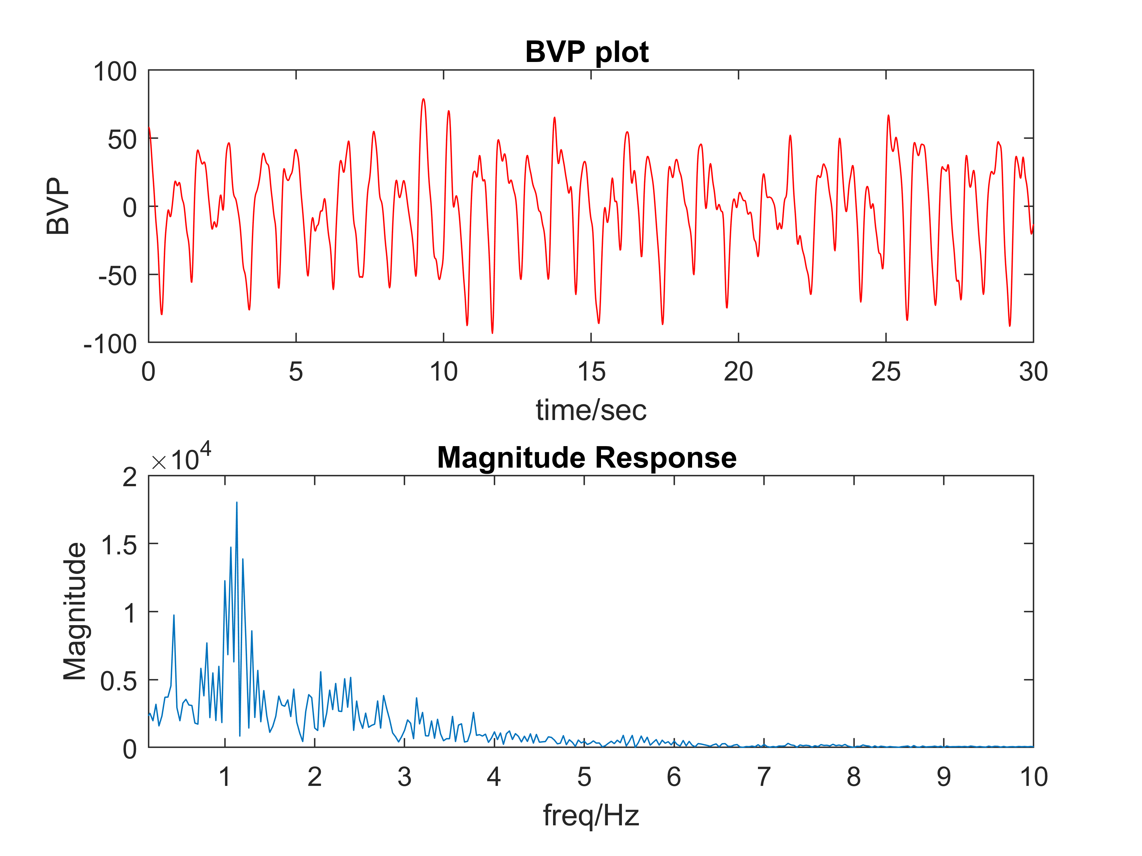
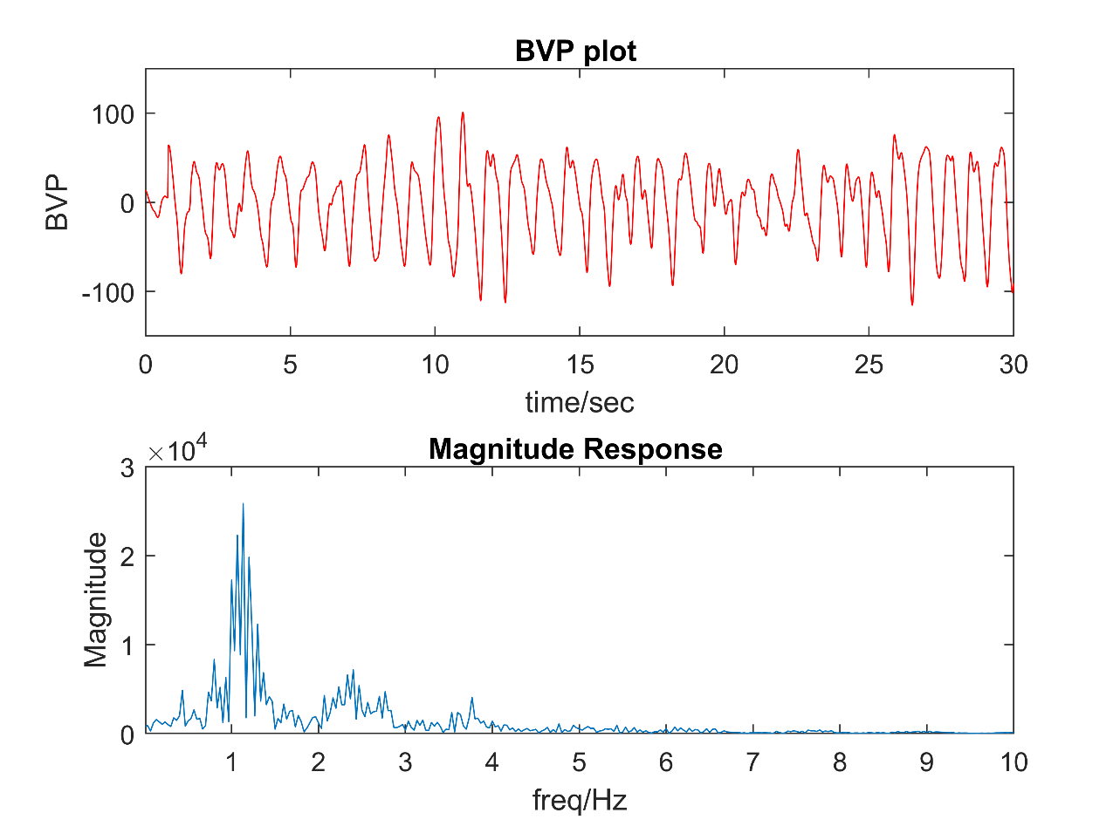
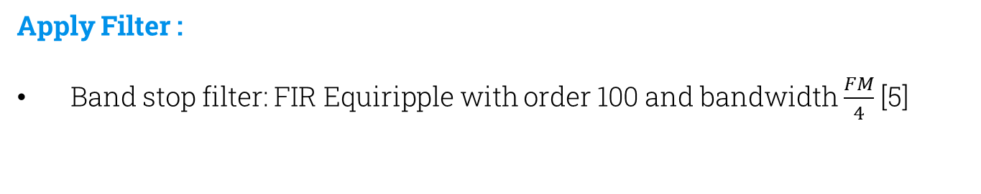
Apply Filter :
Band stop filter: FIR Equiripple with order 100 and bandwidth $\frac{FM}{4}$ [5]
(A)
(B)
Filtered BVP using frequency of motion in the accelerometer data of E4 (A) Before (B) After

Slide 35
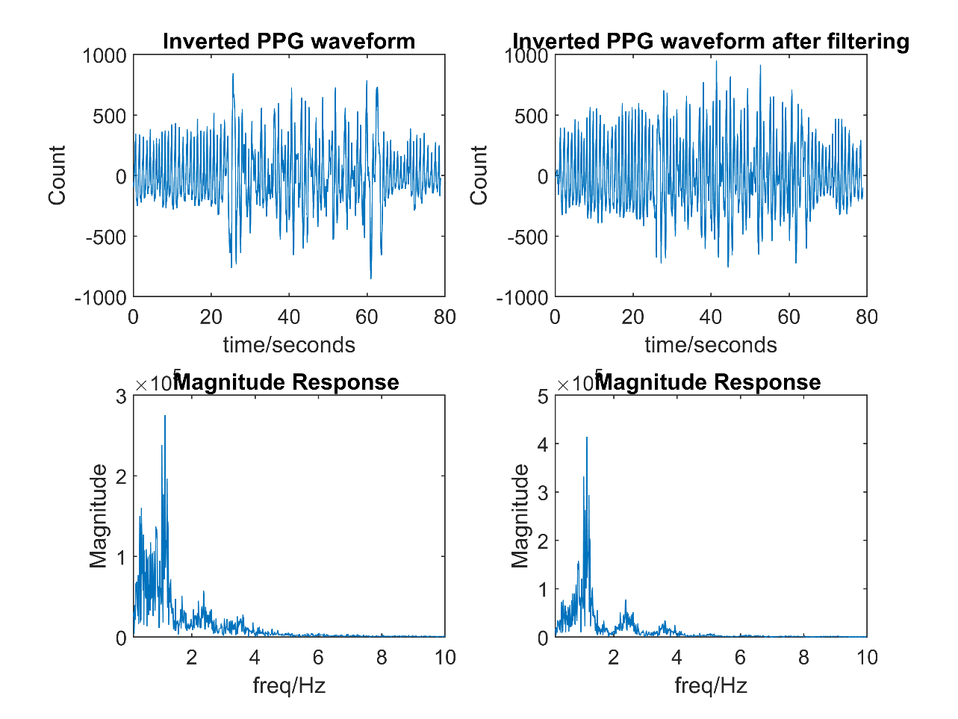
Repeated with MAXREFDES103
Comparison of inverted PPG waveform before and after eliminating frequencies of motion using MAXREFDES103

Slide 36
Conclusion
Correlation do exist
Motion artifacts removed to some extent
Noise frequencies > 0.5 Hz cannot be filtered without having the risk of losing vital PPG information

Slide 37
Future Work
Motion Artifact Removal
Explore and implement other algorithms
Health Parameter Approximation from Perfusion
Extract and analyze feature parameters
Expand our Dataset
Diversify across age and gender

Slide 38
Thank You!
Any Questions?

Slide 39
References:
[1] S. Naseem, U. K. Khattak, H. Ghazanfar, and A. Irfan, \Prevalence of noncommunicable diseases and their risk factors at a semi-urban community, Pakistan," Pan Afr Med J, vol. 23, p. 151, 2016.
[2] S. Lee, G. Ha, D. Wright, Y. Ma, E. Sen-Gupta, N. Haubrich, P. Branche, W. Li, G. Huppert, M. Johnson, B. Mutlu, K. Li, N. Sheth, J. Wright, y.-s. Huang, M. Mansour, J. Rogers, and R. Ghaari, \Highly exible, wearable, and disposable cardiac biosensors for remote and ambulatory monitoring,“ npj Digital Medicine, vol. 1, 12 2018.
[3] C. Fischer, M. Glos, T. Penzel, and I. Fietze, \Extended algorithm for realtime pulse waveform segmentation and artifact detection in photoplethysmograms,“ Somnologie, vol. 21, pp. 1-11, 05 2017.
[4] Charlton P.H., Villarroel M., Salguiero F. (2016) Waveform Analysis to Estimate Respiratory Rate. In: Secondary Analysis of Electronic Health Records. Springer, Cham. https://doi.org/10.1007/978-3-319-43742-2_26
[5]S. Nabavi and S. Bhadra, ”A robust fusion method for motion artifacts reduction in photoplethysmography signal," IEEE Transactions on Instrumentation and Measurement, vol. PP, pp. 1-1, 07 2020.

